Slide 1
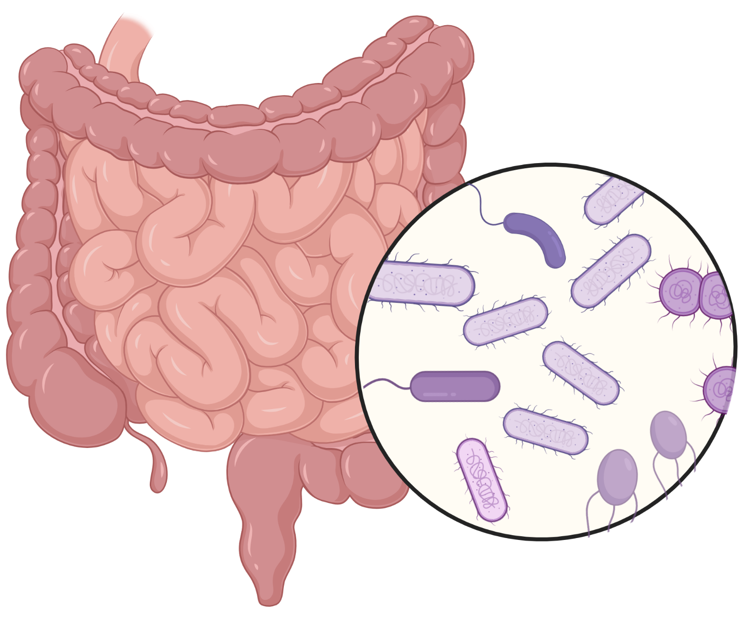
Intestinal microbial communities are well-established as critical to MDRO colonization resistance.

Slide 2
Woodworth et al, OFID, 2019
Notes:
FMT
Instillation of stool (usually filtered and diluted with saline) from a screened, healthy donor to treat disease
Best understood in setting of RCDI, where treatment results are up to 90% efficacy when including repeat treatments
Other conditions have been associated with low microbial diversity, which is occasionally described as dysbiosis
These associations have motivated clinical study of the use of FMT for potential benefits other than RCDI. In particular, the potential to reduce multi-drug resistant organism colonization is gaining attention. If demonstrated to be safe and effective for MDRO colonization, FMT (and/or related microbial therapies) could have major implications in addressing threats of antimicrobial resistance globally.

Slide 3
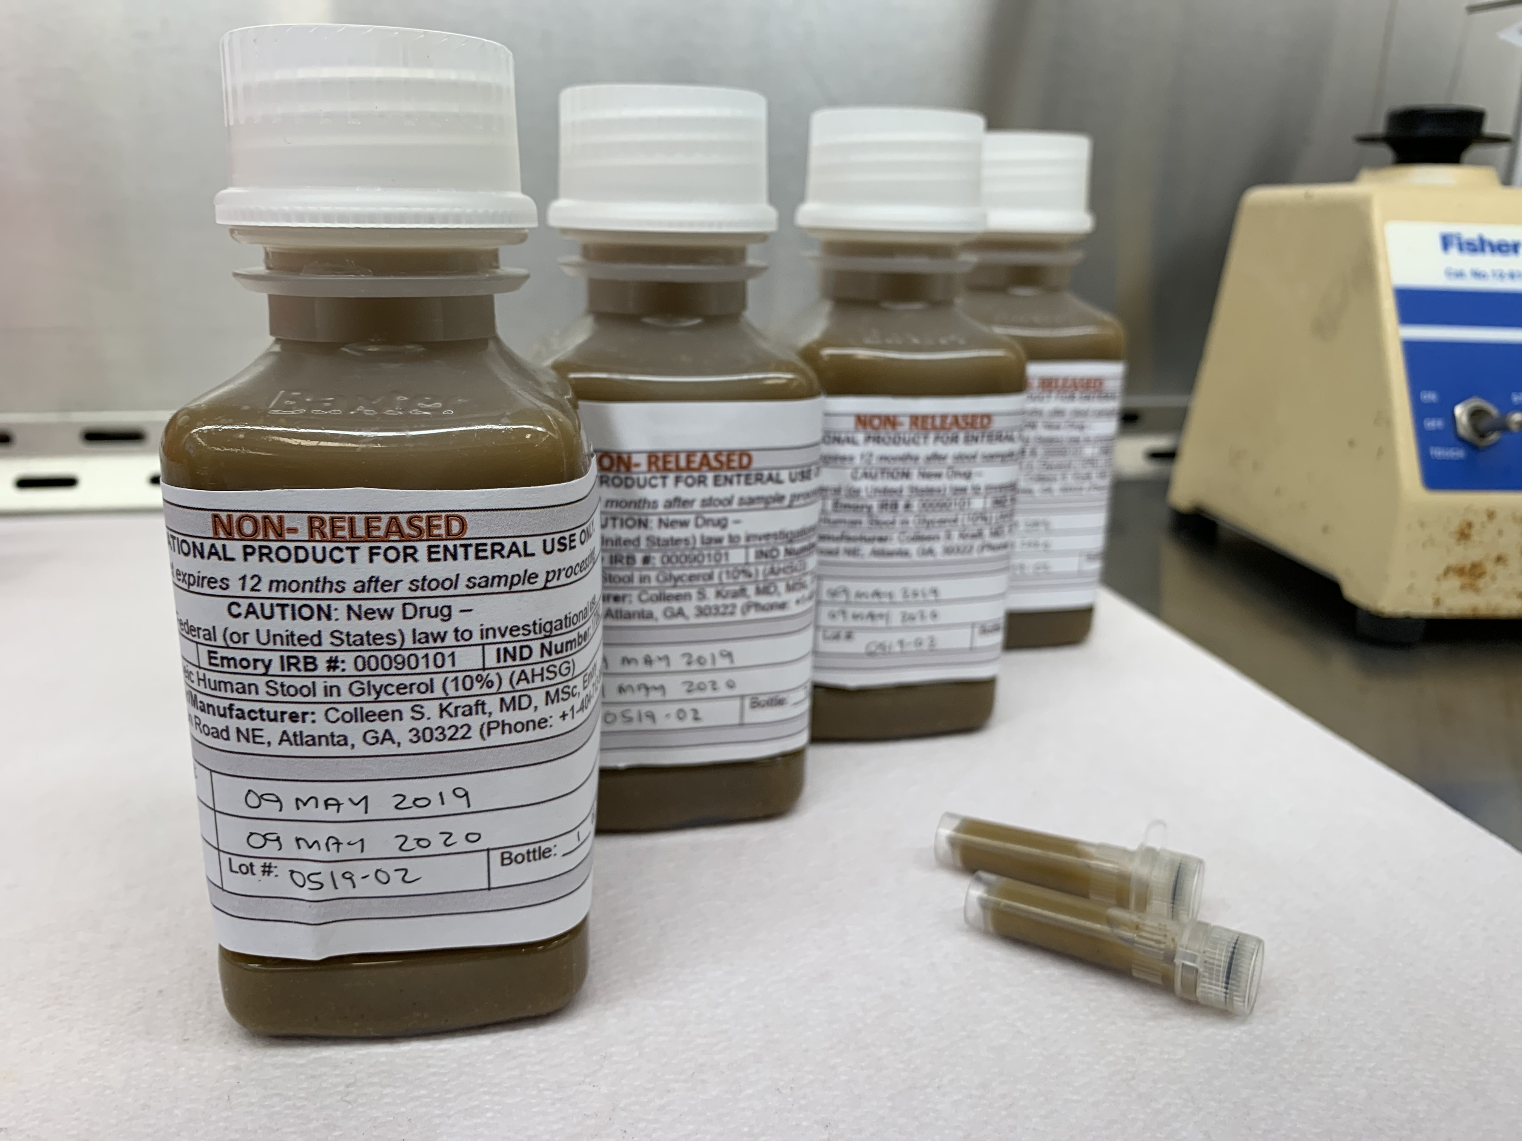

Slide 4
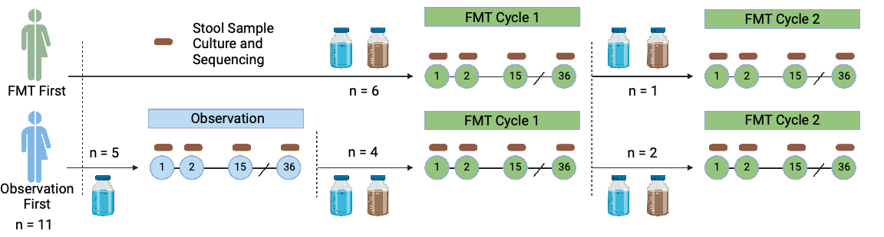

Slide 5
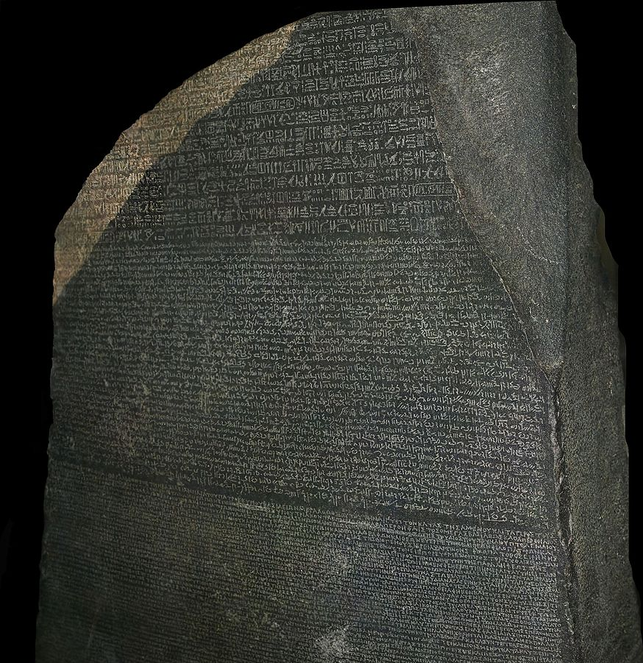
https://commons.wikimedia.org/w/index.php?curid=3153928 © Hans Hillewaert, CC BY-SA 4.0,

Slide 6
Microbiota
Shorthand for all microbes present in a sample / environment

Slide 7
Microbiome
Sum genetic content of all microbes present [i.e. microbiota]

Slide 8
Microbiome
Holistic view integrating microbes and their environment [e.g. human host]

Slide 9
-omics
Study of everything

Slide 10
gen-omics
Study of complete set of DNA of an organism

Slide 11
(pan)gen-omics
Study of complete set of DNA of multiple organisms of the same type

Slide 12
metagen-omics
Study of DNA from a sample with multiple organisms

Slide 13
metabol-omics
Study of all metabolites from a sample

Slide 14
resist-ome
Study of all resistance genes from a sample

Slide 15
What types of questions can be asked?
A brief overview of microbiome analytic approaches

Slide 16
diversity
Ecological indices to compare sample composition or configuration.

Slide 17


α diversity
LOW
HIGH
Within-sample diversity (richness, evenness, Shannon index etc)
Notes:
Richness is number of species / taxa in a sample, evenness estimates distribution of abundance of species,

Slide 18
β diversity
LOW
HIGH
Between-sample diversity (dissimilarity, similarity, Bray-Curtis, Jaccard)
Notes:
Richness is number of species / taxa in a sample, evenness estimates distribution of abundance of species,

Slide 19
diversity
No information about features that drive differences

Slide 20
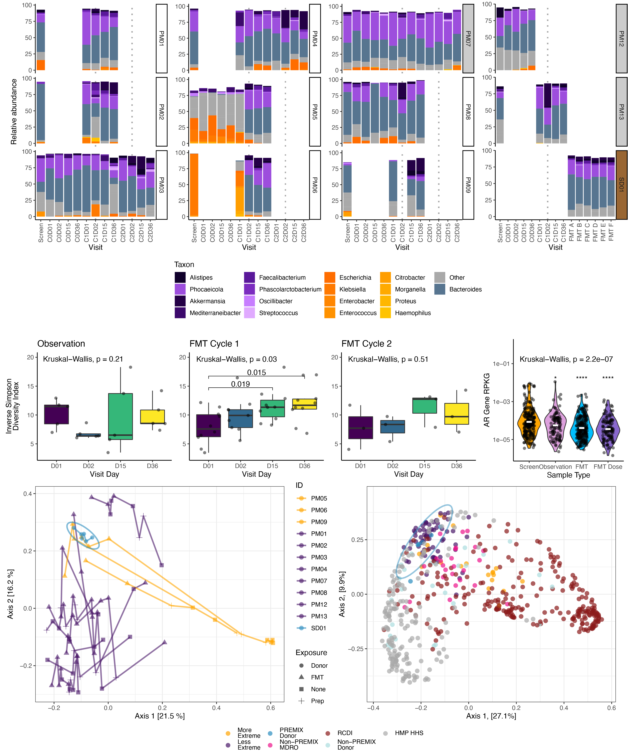
Alpha diversity increased after FMT

Slide 21
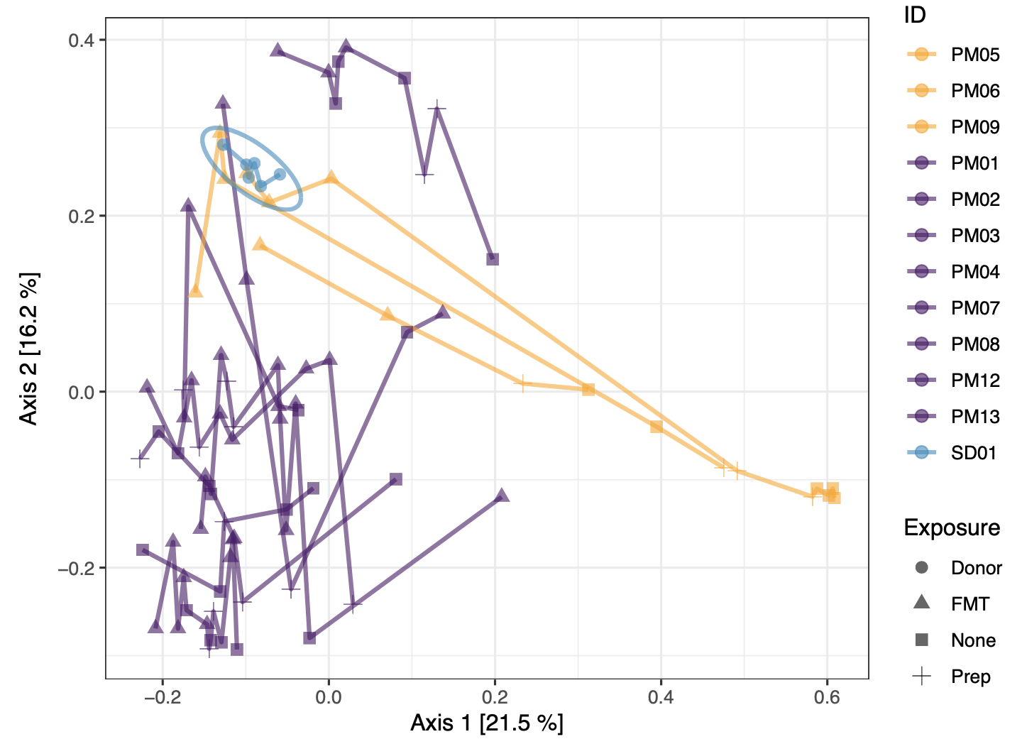

Slide 22
abundance
How much of something – relative (compositional) or absolute

Slide 23
Pathogen colonization is a low-abundance phenomenon for most RTRs

Slide 24
RTR taxonomic trajectory driven by selected FMT-derived taxa

Slide 25
Source of strains

Slide 26
Source of strains
[A word about coverage breadth & depth]

Slide 27


RESISTANT
SUSCEPTIBLE

Slide 28

RESISTANT
SUSCEPTIBLE

Slide 29
x
20% BREADTH
RESISTANT
✓
100% BREADTH
SUSCEPTIBLE

Slide 30
<1 X COVERAGE (DEPTH)
RESISTANT
2.5 X COVERAGE (DEPTH)
SUSCEPTIBLE

Slide 31
Source of Strains

Slide 32
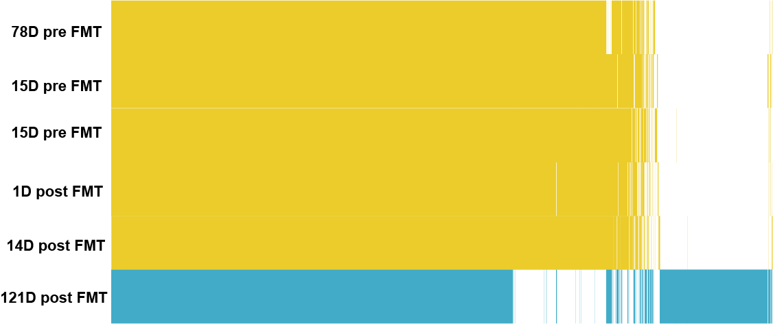
Clonal chronic colonizing strain is replaced by a more-susceptible, host-derived strain after FMT
PM01 E. coli pangenome

Slide 33

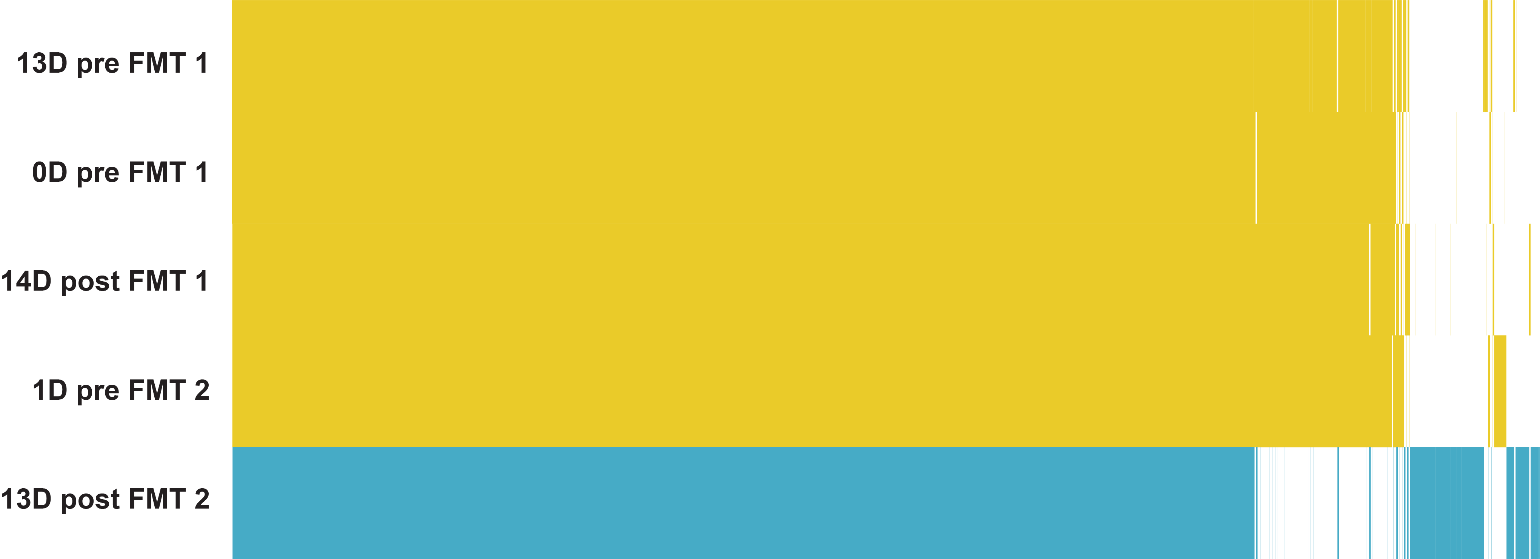
PM03 Klebsiella pneumoniae strain switch
PM04 Escherichia coli strain switch

Slide 34
Predict functional changes

Slide 35
